Slide 1
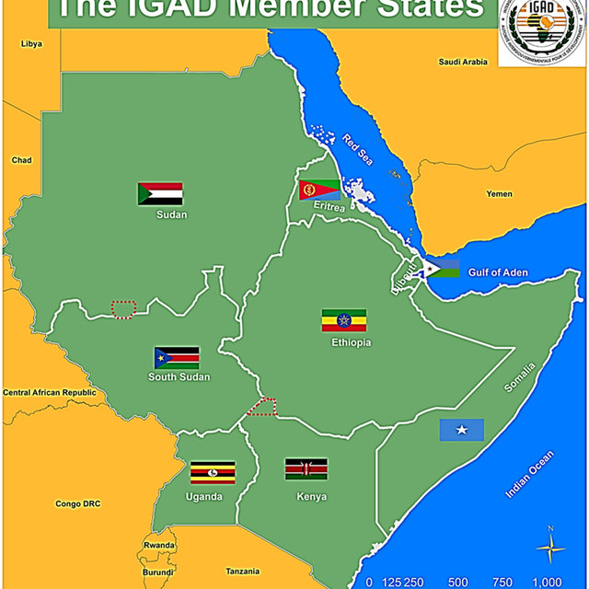
Geography Of Ethiopia & The Horn
(LART 1004)
Tesfaye Abebe(MSc)

Slide 2
CHAPTER ONE
1.1. Geography: Definition, Scope and Themes
Objectives
At the end of this chapter, the learners will be able to:
Comprehend the meaning and scope of Geography.
Explain the themes of Geography.
Explicate the implications of location, shape and size of Ethiopia and the Horn on the physical environment, socioeconomic and political aspects.
Acquire basic skills of map reading.

Slide 3
INTRODUCTION
1.1. Geography: Definition, Scope and Themes
1.1.1. Meaning of Geography
Geography is the scientific study of the Earth that describes and analyses spatial and temporal variations of physical, biological and human phenomena, and their interrelationships and dynamism over the surface of the Earth.

Slide 4
1.1.2. The Scope, Approaches and Themes of Geography
Geography is a holistic and interdisciplinary field of study contributing to the understanding of the changing spatial structures from the past to the future.
The scope of Geography:-
is the surface of the Earth, which includes
Atmosphere,
Lithosphere,
Hydrosphere and
Biosphere, which provides the habitable zone in which humans are able to live

Slide 5
Geography can be approached
Geography can be approached by considering two continuums:
a human-physical continuum and
a topical-regional continuum.
The topical (systematic) fields of Geography view particular categories of physical or human phenomena as distributed over the Earth.
Regional geography is concerned with the associations within regions of all or some of the elements and their interrelationships.

Slide 6
Themes of Geography
Geography has five basic themes
Location:- is defined as a particular place or position.
Location can be of two types:
Absolute location and
Relative location
Place:- Refers to the physical and human aspects of a location.
is associated with toponym (the name of a place), site (the description of the features of the place), and situation (the environmental conditions of the place).
Each place in the world has its unique characteristics expressed in terms of landforms, hydrology, biogeography, pedology, characteristics and size of its human population, and the distinct human cultures.

Slide 7
3. Human-Environment Interaction
Humans have always been on ceaseless interaction with their natural environment
involves three distinct aspects:
dependency,
Adaptation and
Modification.
Dependency:-refers to the ways in which humans are dependent on nature for a living.
B. Adaptation:-relates to how humans modify themselves, their lifestyles and their behaviour to live in a new environment with new challenges.
C. Modification:-allowed humans to “conquer” the world for their comfortable living.

Slide 8
4. Movement
Movement entails to the translocation of human beings, their goods, and their ideas from one end of the planet to another.
Physical movement of people
Transport of goods and
The flow of ideas
5. Region
is a geographic area having distinctive characteristics that distinguishes itself from adjacent unit(s) of space.
Formal region that is characterized by homogeneity in terms of a certain phenomenon (soil, temperature, rainfall, or other cultural elements like language, religion, and economy).
Functional or nodal region characterized by functional interrelationships in a spatial system defined by the linkages binding particular phenomena.

Slide 9
1.2. Location, Shape and Size of Ethiopia and the Horn
The Horn of Africa:- is a narrow tip that protrudes into the northern Indian Ocean, separating it from the Gulf of Aden.
is home to the countries of Djibouti, Eritrea, Ethiopia, and Somalia, whose cultures have been linked throughout their long history
In terms of size, Ethiopia is the largest of all the Horn of African countries, while Djibouti is the smallest.

Slide 11
1.2.1. Location of Ethiopia
The location of a country or a place on a map or a globe is expressed in two different ways.
These are:-
Astronomical and
Relative locations
Astronomical location, also known as absolute or mathematical location,
States location of places using the lines of latitudes and longitudes.
Astronomically, Ethiopia is located between
3°N (Moyale) and 15°N (Bademe) latitudes
33°E (Akobo) to 48°E(Ogaden) longitudes

Slide 12
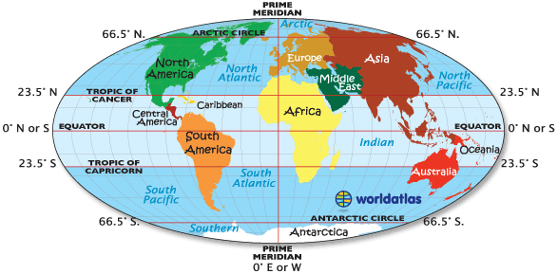
The east west distance (15°) is longer than the north-south distance (12°).
The latitudinal and longitudinal extensions are important in two ways
The country experiences tropical climate and
There is a difference of one hour between the most easterly and most westerly points of the country

Slide 13
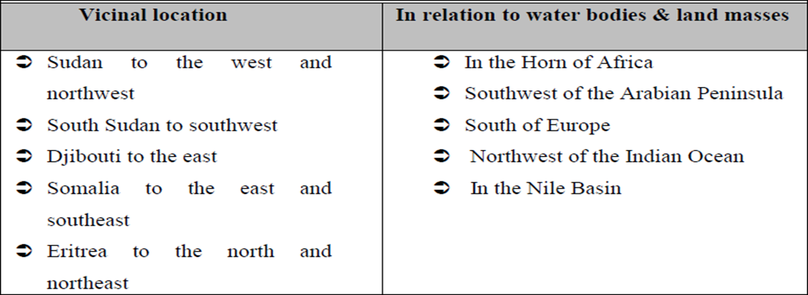
Relative location:- expresses the location of countries or places with reference to the location of other countries (vicinal), landmasses or water bodies

Slide 14
The implications of the location of Ethiopia
Climate: The fact that Ethiopia is located between 3°N and 15°N (between the Equator and Tropic of Cancer) implies that the country has a tropical climate, though modified by its altitude.
b) Socio-cultural: Ethiopia is one of the earliest recipients of the major world religions namely Christianity, Islam and Judaism due to its proximity to the Middle East.
The linguistic and other cultural relationships, which Ethiopia shares with its neighbours, reflect the influence of location

Slide 15
c) Political: The political history of Ethiopia has been considerably influenced by:
Geopolitical considerations of superpowers.
Adjacency to the Red Sea (a major global trade route).
The Middle East geopolitical paradigms.
As a result, Ethiopia has been exposed for external invasions in a number of times; though the country resisted foreign intervention and remains free of external domination

Slide 16
1.2.2. Size of Ethiopia
Ethiopia with a total area of approximately 1,106,000 square kilometres is the 8th largest country in Africa and 25th in the World.
It extends about 1,639 kilometres East-West, and 1,577 kilometres North-South.
About 0.7% of the country is covered by water bodies

Slide 17
Advantages and disadvantages of Ethiopia’s large size

Slide 18
1.2.3. The shape of Ethiopia and its Implication
Five main categories of shape of a country:
Compact shape countries:-The distance from the geographic centre of the state to any of the borders does not vary greatly
It is easier for defence, socioeconomic and cultural integration.
Fragmented shape countries: Countries divided from their other parts by either water, land or other countries.(E.g. Philippines)
Elongated shape countries:- They are geographically long and relatively narrow(E.g. Chile and Vietnam)
Perforated shape countries:- A country that completely surrounds another country like the Republic of South Africa
Protrude shape countries:- Countries that have one portion that is much more elongated than the rest of the country like Myanmar , Eritrea and Thailand …

Slide 20
measuring shape of countries
There are various ways of measuring shape of countries. These measures are known as the indices of compactness.
Measures deviation of the shape of a country from a circular shape,
Four most commonly used measures of compactness
Area-Boundary ratio
Boundary-Circumference ratio
Area-Circumference ratio
Area-Area (A/A‟) ratio

Slide 21
Area-Boundary ratio.:-The higher the A/B ratio, the greater the degree of compactness
Boundary-Circumference ratio:-The ratio of boundary length of a country to the circumference of a circle having the same area as the country itself:
It measures how far the boundary of a country approximates the circumference of a circle of its own size.
Therefore, the nearer the ratio to 1 the more compact the country is.
Area-Circumference ratio:-The ratio of the area of the country to the circumference of the smallest inscribing circle
It compares the area of the country with the circumference of a circle that passes touching the extreme points on the boundary of the country.
The higher the A/C ratio, the greater the degree of compactness.

Slide 22
Area (A/A) ratio
The ratio of the actual area of a country to the smallest possible inscribing circle
The area of the inscribing circle is the area of the smallest possible circle whose circumference passes through the extreme points on the boundary.
Half-length of the longest distance between two extreme points gives radius of the inscribing circle.
The nearer the ratio to 1, the more compact the country is.

Slide 23
1.3. Basic Skills of Map Reading
What is a Map?
A map is a two-dimensional scaled representation of part or whole of the Earth surface on a flat body such as piece of paper, black board, wood or cloth.
have a special significance for Geographers as primary tools for displaying and analyzing spatial distributions, patterns and relations.

Slide 24
Importance of maps
Provide the basis for making geographical details of regions represented i.e. the geographical facts of an area such as relief, drainage, settlement etc.
for making spatial analysis of geographical facts of areas represented.
Useful for giving location of geographical features by varied methods of grid reference, place naming etc.
Used on various disciplines like land use planning, military science, aviation, tourism, marine science, population studies, epidemiology, geology, economics, history, archaeology, agriculture etc.
…Storage of the geographical data of areas represented.
To asses‟ reliable measurements of the geographical features. The measurements can be of area size, distance etc.

Slide 25
Types of Map
There are many types of maps according to their purpose and functions. For the purpose of this course, topographical and statistical maps are considered.
Topographical maps: Topographic maps depict one or more natural and cultural features of an area.
Special purpose/statistical maps: These are maps, which show distribution of different aspects such as temperature, rainfall, settlement, vegetation etc.

Slide 26
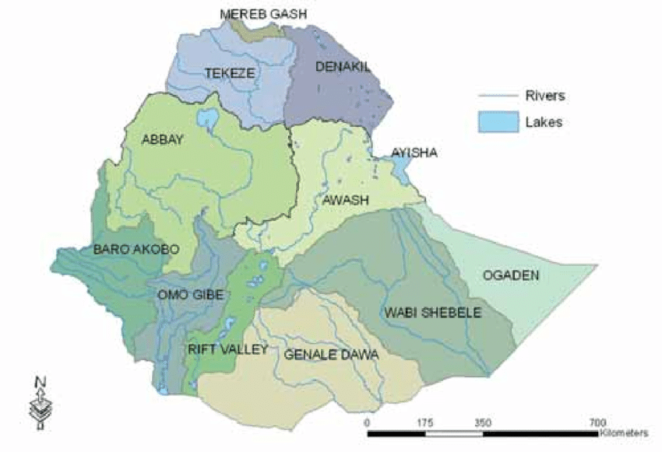

Slide 27
Marginal Information on Maps (Elements of Maps)
Enable the reading and interpretation of the geographical information of an area represented.
This includes:
Title ….tells what the map is all about
Key (legend)…list of all symbols and signs shown on the map
Scale: It is the ratio between the distance on the map and the actual ground distance. It can be expressed as representative fraction, statements/verbal scale, and linear (graphic) scale
North arrow: …north direction on a map
Margin….is the map frame
Date of compilation: …date of map publication

Slide 28
Basic Principles of Map Reading
Map Readers must have ideas about the symbol and also the real World (landscapes)
Knowledge of directions
End of Chapter One

